Slide 1







24
7
30
Date
Topic:
EQ –
Up to now we have been looking at equations like:
$$y=x^{2}+bx+c$$
What happens if we also have
$$y^{2}$$
Let’s try it out and discover what happens
$$x^{2}+y^{2}=4$$
When x=2, what does y = ?
$$2^{2}+y^{2}=4$$
$$4+y^{2}=4$$
$$y^{2}=0$$
So $y=0$
Notes:
Lesson objective (EQ)

Slide 2




24
7
30
Date
Topic:
EQ –
x | -2 | -1 | 0 | 1 | 2
y |  |  |  |  | 0
When x = -2, what does y = ?
$${(−2)}^{2}+y^{2}=4$$
$$4+y^{2}=4$$
$$y^{2}=0$$
So $y=0$
x | -2 | -1 | 0 | 1 | 2
y | 0 |  |  |  | 0
Notes:
Lesson objective (EQ)

Slide 3




24
7
30
Date
Topic:
EQ –
When x = 0, what does y = ?
$$0^{2}+y^{2}=4$$
$$0+y^{2}=4$$
$$y^{2}=4$$
So $y=2 or y=−2$
x | -2 | -1 | 0 | 1 | 2
y | 0 |  | 2 or -2 |  | 0
Now lets plot these points
Notes:
Lesson objective (EQ)

Slide 4
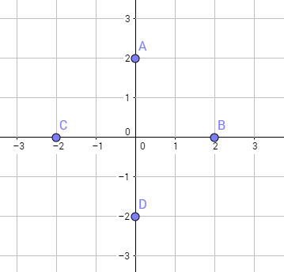
24
7
30
Date
Topic:
EQ –
y
x
x | -2 | -1 | 0 | 1 | 2
y | 0 |  | 2 or -2 |  | 0
Notes:
Lesson objective (EQ)

Slide 5


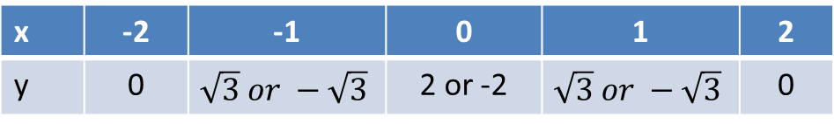






24
7
30
Date
Topic:
EQ –
When x = 1, what does y = ?
$$1^{2}+y^{2}=4$$
$$1+y^{2}=4$$
$$y^{2}=3$$
So $y=\sqrt{3} or y=−\sqrt{3}$
When x = -1, what does y = ?
$${(−1)}^{2}+y^{2}=4$$
$$1+y^{2}=4$$
$$y^{2}=3$$
So $y=\sqrt{3} or y=−\sqrt{3}$
x | -2 | -1 | 0 | 1 | 2
y | 0 | $$\sqrt{3} or −\sqrt{3}$$ | 2 or -2 | $$\sqrt{3} or −\sqrt{3}$$ | 0
Notes:
Lesson objective (EQ)

Slide 6
24
7
30
Date
Title
EQ –
Notes:
Input

Slide 7
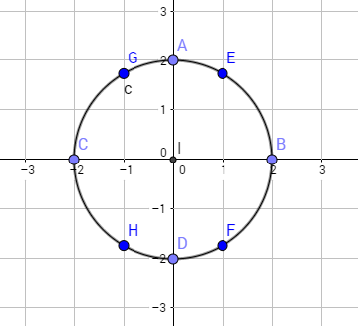
24
7
30
Date
Title
EQ –
Notes:
Input

Slide 8

24
7
30
Date
Topic: Circles
EQ – What is the format for the equation of a circle?
$$x^{2}+y^{2}=a^{2}$$
Practice questions
Page 56 Ex 4.7, Q 1-3
Homework: Write your summaries for Algebra!!!!
Notes:
Input

